Slide 1
Basics of WLAN

Slide 2
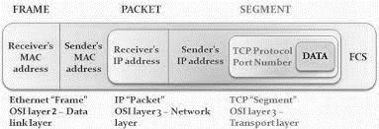

Slide 3
The Type field defines the type of WLAN frame, which has three possibilities:
1. Management frames:
2. Control frames:
3. Data frames:

Slide 4
Management Frames
Management frames are responsible for maintaining communication between the access points and wireless clients. The Management frames can have the following sub-types:
..Authentication
..De-authentication
..Association Request
..Association Response
..Reassociation Request
..Reassociation Response
..Disassociation
..Beacon
..Probe Request
..Probe Response

Slide 5
Control Frames
Control frames ensures a proper exchange of data between the access point and wireless clients. Control frames can have the following sub-types:
..Request to Send (RTS)
..Clear to Send (CTS)
..Acknowledgement (ACK)

Slide 6
Data Frames
Data frames carry the actual data sent on the wireless network. There are no sub-types for data frames.

Slide 7
WPA/WPA2
WPA/WPA2 PSK is vulnerable to a dictionary attack. The inputs required for this attack are the four-way WPA handshake between client and access point, and a wordlist containing common passphrases.
Notes:
Wi-Fi Protected Access

Slide 8
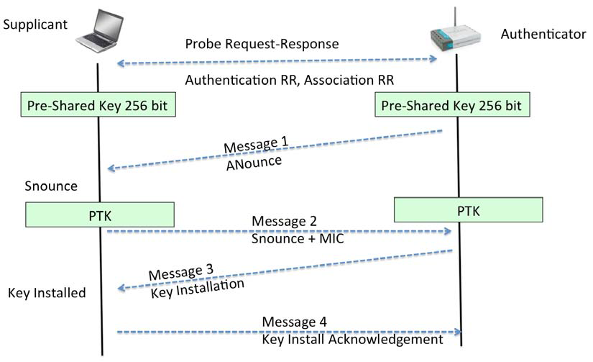
Four-Way Handshake

Slide 9
PTK
The way WPA/WPA2 PSK works is that, it derives the per-sessions key called Pairwise Transient Key (PTK), using the Pre-Shared Key and five other parameters
SSID of Network
Authenticator Nounce (Anounce)
Supplicant Nounce (SNounce)
Authenticator MAC address (Access Point MAC),
Suppliant MAC address (Wi-Fi Client MAC).
This key is then used to encrypt all data between the access point and client.

Slide 10
PTK
The WAP's nonce value is called ANonce. With this information, the client is able to derive the pairwise transient key (PTK), which is required to encrypt traffic between the client and the WAP.

Slide 11
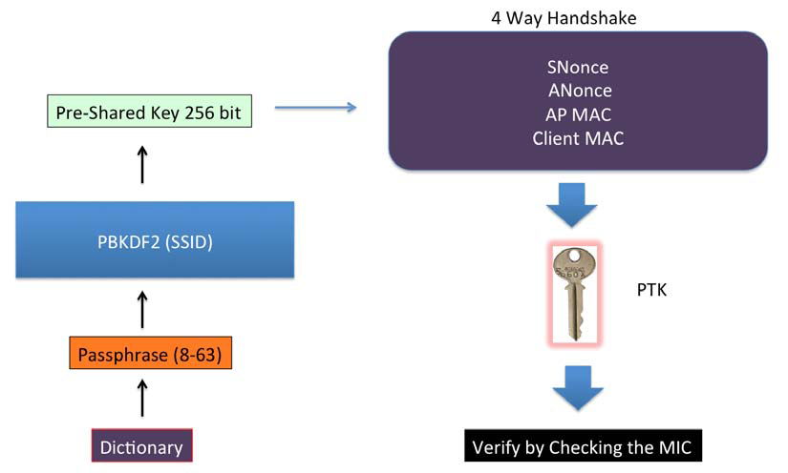
Understanding PTK generation
Notes:
Message integrity check

Slide 12
What is an IP and MAC?
IP – Internet Protocol
IPv4
IPv6
MAC – Media Access Control Address
Related to hardware
Notes:
Ipconfig /all

